Slide 1
Energy Consumption Analysis

Slide 2
Introduction
This project focuses on Worldwide Energy Consumption Analysis using a structured dataset provided by the EIA (Energy Information Administration). The dataset includes key aspects such as energy consumption, production, emissions, GDP, and population across different countries.
The main objective of this project is to explore the relationship between economic growth, energy usage, and environmental impact. By analyzing patterns of energy production and consumption, emissions, and per capita trends, we aim to understand how countries balance their energy demands with sustainability goals.

Slide 3
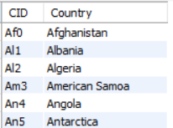
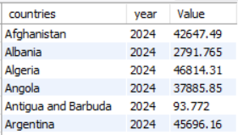
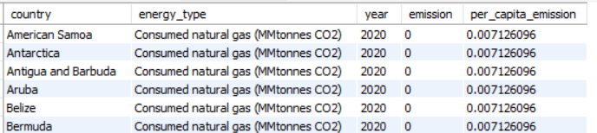
Tables
Country
Population
Emission_3

Slide 4
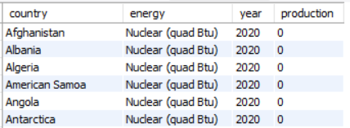
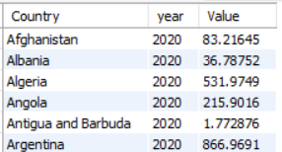
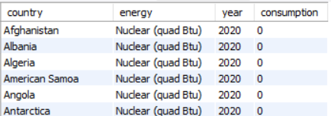
Production
GDP_3
Consumption

Slide 5
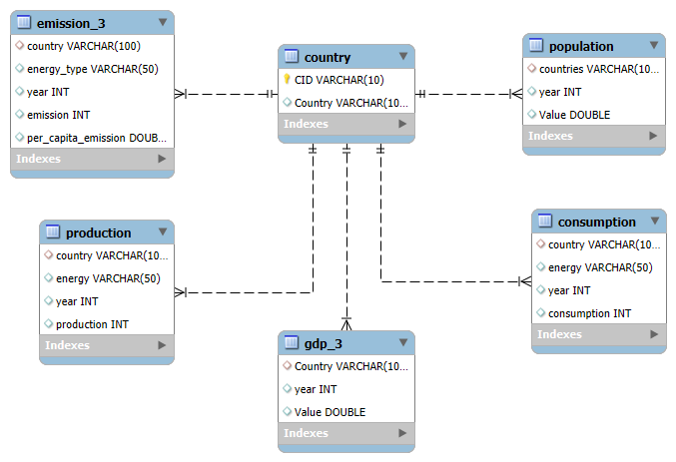
ER Diagram

Slide 6
Problem Statement
With the rapid growth of population and industrialization, global energy demand is increasing at an unprecedented rate. This rise in consumption is directly linked to higher emissions, impacting climate change and sustainability goals.
However, energy production, consumption, and emissions vary significantly across countries, depending on their economic strength, population size, and energy policies. While some nations rely heavily on fossil fuels, others are moving towards renewable energy sources.

Slide 7

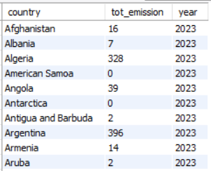
1.What is the total emission per country for the most recent year available?

Slide 8

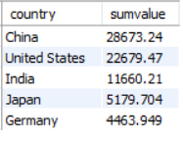
2.What are the top 5 countries by GDP in the most recent year?

Slide 9

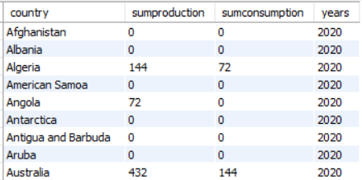
3.Compare energy production and consumption by country and year?

Slide 10
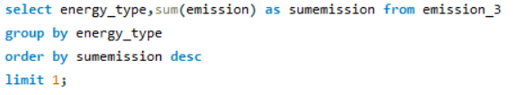
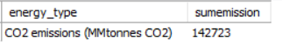
4.Which energy types contribute most to emissions across all countries?

Slide 11

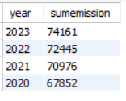
5.How have global emissions changed year over year?

Slide 12

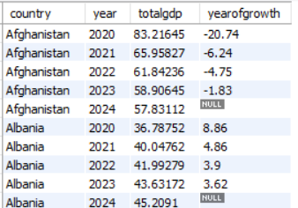
6.What is the trend in GDP for each country over the given years?

Slide 13
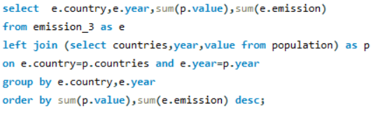
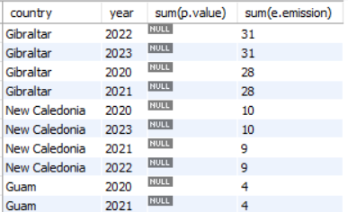
7.How has population growth affected total emissions in each country?

Slide 14

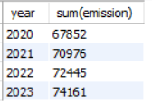
8.Has energy consumption increased or decreased over the years for
major economies?

Slide 15
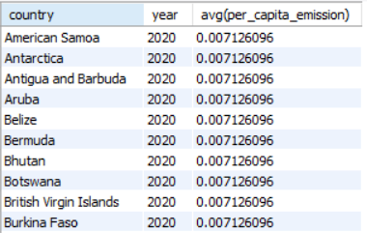
9.What is the average yearly change in emissions per capita for each country?

Slide 16
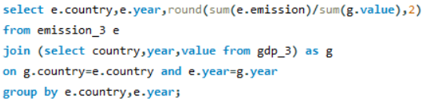
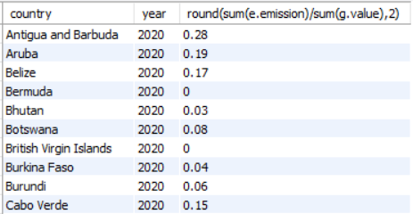
10.What is the emission-to-GDP ratio for each country by year?

Slide 17
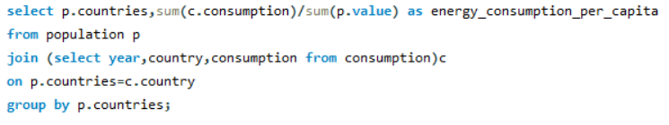
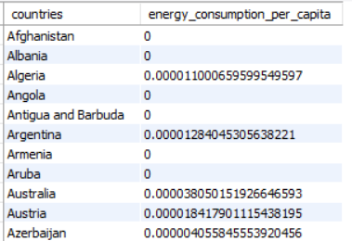
11.What is the energy consumption per capita for each country over the last decade?

Slide 18
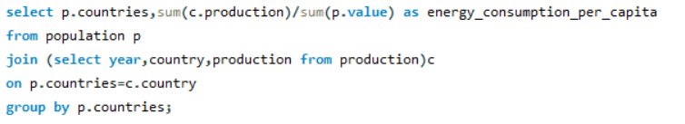
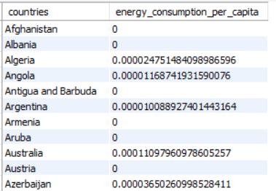
12.How does energy production per capita vary across countries?

Slide 19

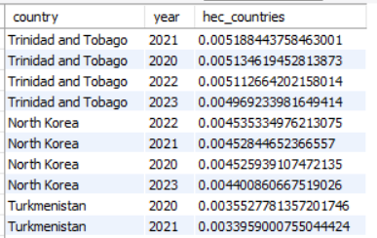
13.Which countries have the highest energy consumption relative to GDP?

Slide 20

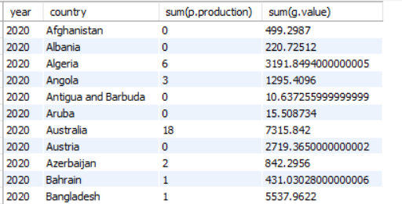
14.What is the correlation between GDP growth and energy production growth?

Slide 21
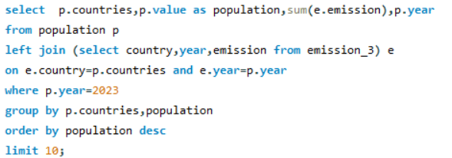
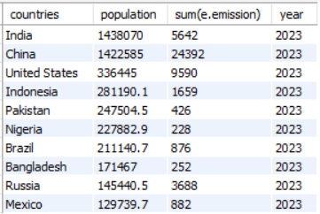
15.What are the top 10 countries by population and how do their emissions compare?

Slide 22
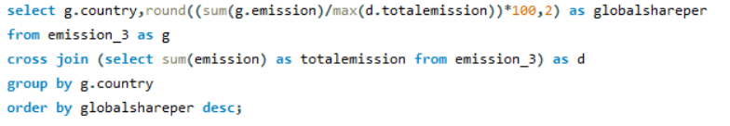
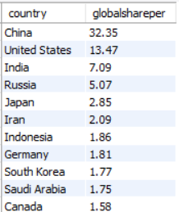
16.What is the global share (%) of emissions by country?

Slide 23
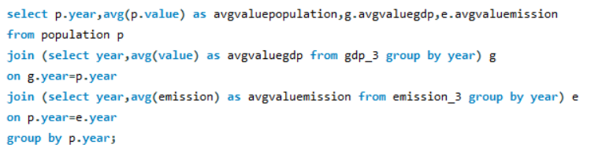
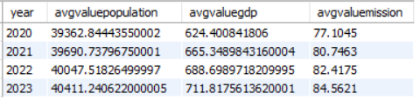
17.What is the global average GDP, emission, and population by year?

Slide 24
Thank You
for your Attention
Group Members :
S SHAREEF
K RAGHAVENDRA
G ARYAN

